Slide 1
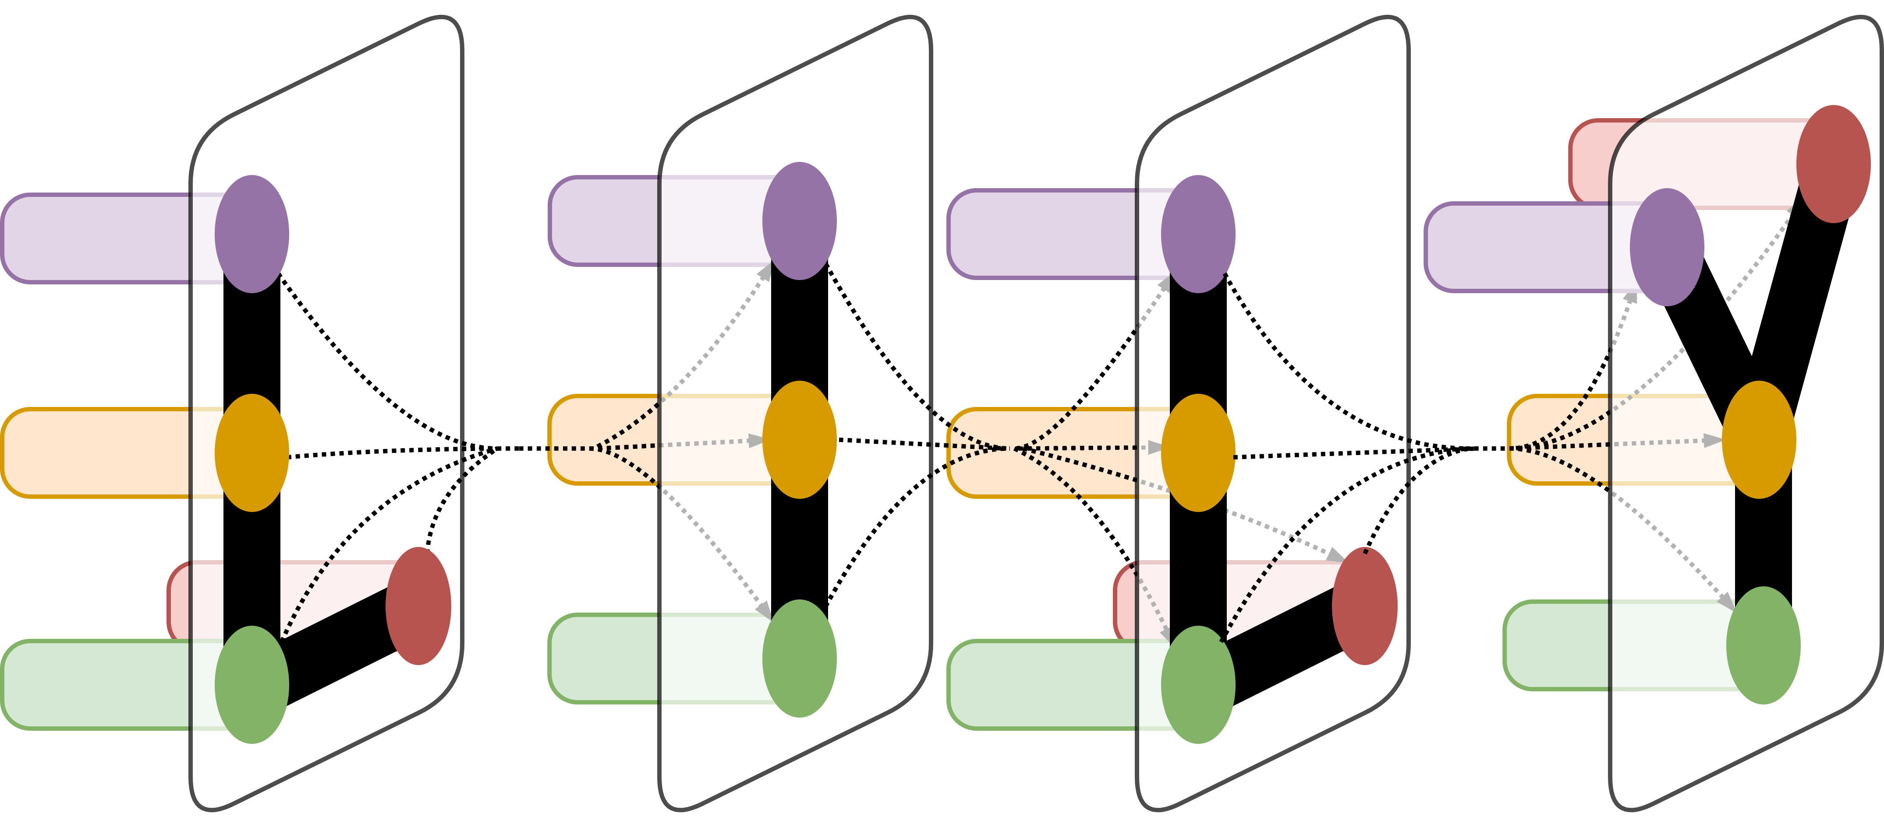
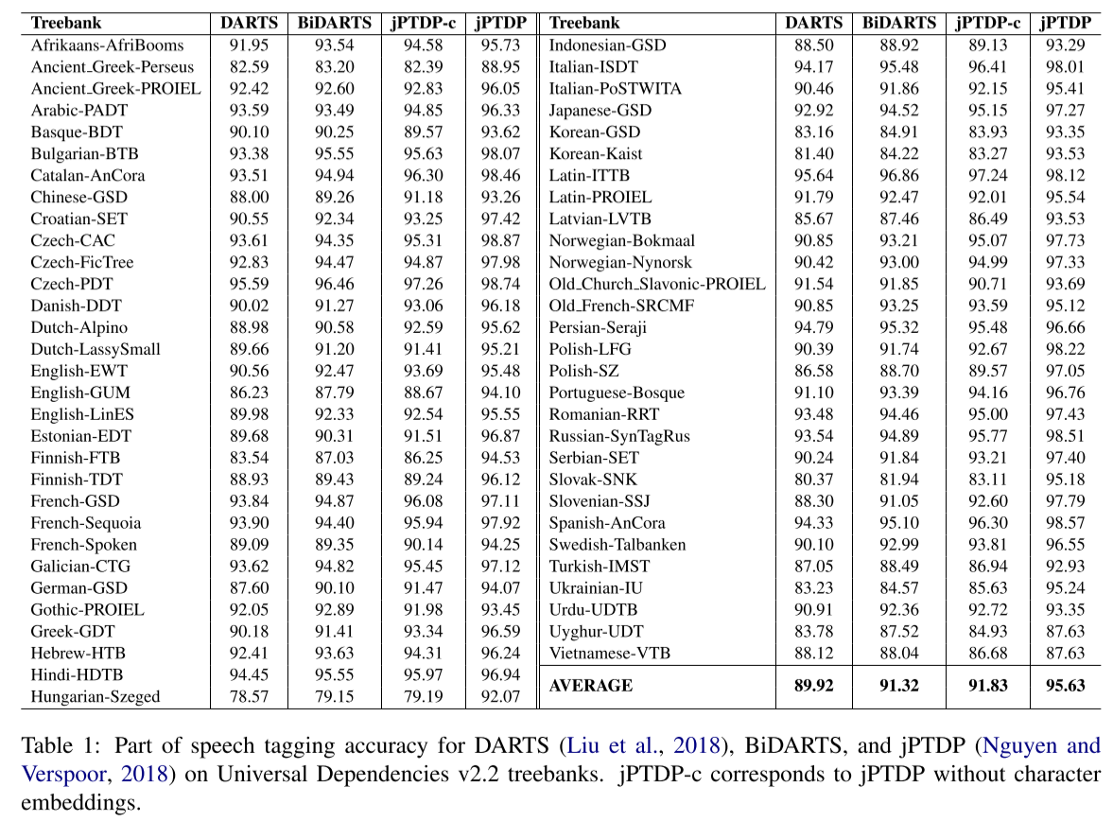
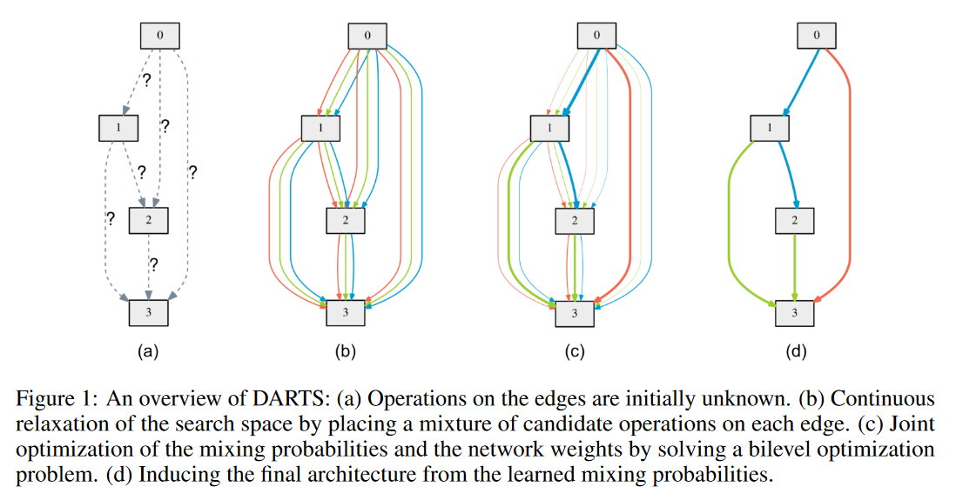
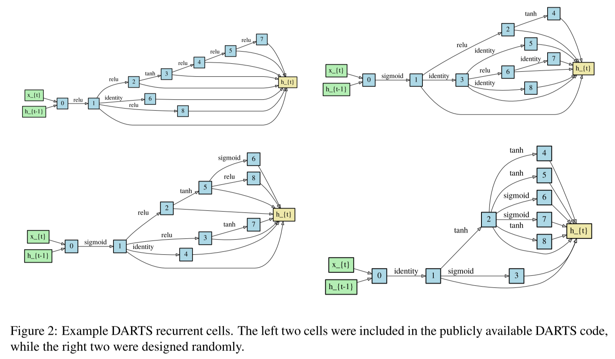
Part of Speech Tagging with Neural Architecture Search
Garrett Bingham and Dragomir Radev
Department of Computer Science, Yale University, New Haven, CT
LILY Lab
Introduction
Results
Recent neural architecture search techniques have achieved state-of-the-art performance in image classification and language modeling, but applications to other machine learning tasks have been lacking. We present the first application of neural architecture search to part of speech tagging. We adapt the DARTS approach to neural architecture search (Liu et al., 2018) to part of speech tagging and achieve encouraging performance. We then introduce BiDARTS, a bidirectional version of DARTS. BiDARTS consistently outperforms DARTS on part of speech tagging, and an ablation study shows BiDARTS is competitive with a state-of-the-art part of speech tagger. We conclude with a surprising empirical result that suggests that random DARTS architectures are just as effective as those obtained through extensive architecture search.
Notice that BiDARTS outperforms DARTS in almost every case. As the first bidirectional neural architecture search approach, this suggests that future neural architecture search techniques should consider bidirectional recurrent cells over unidirectional ones whenever feasible.
The performance should be contrasted with the amount of human effort required to design the neural network architectures. While jPTDP required significant time and human effort, the DARTS and BiDARTS architectures were discovered in a single GPU day by executing a single command.
Notably, BiDARTS achieves comparable accuracy with jPTDP when character embeddings are removed. This suggests that the presence of the character embeddings was a principal factor in jPTDP obtaining higher accuracy, and that the BiDARTS architecture is effective at part of speech tagging.
Experiment
Conclusion
Most neural architecture search techniques have been applied to image classification or language modeling. However, the extensive research on image classification and language modeling makes it easy to define a search space that all but guarantees a suitable architecture will be found. Furthermore, basing neural architecture search strategies on previous human success in neural network design introduces a human bias which precludes discovery of novel types of neural networks. Neural architecture search has the potential to make machine learning accessible to non-experts. For this to be useful, it must succeed on a variety of tasks.
To this end, we compare DARTS tagging accuracy with that of jPTDP (Nguyen and Verspoor, 2018), a state-of-the-art part of speech tagger. We also introduce BiDARTS, a bidirectional version of DARTS. We compare the part of speech tagging accuracies across 60 Universal Dependencies v2.2 treebanks.
Neural architecture search has the potential to make machine learning accessible to non-experts However, to date it has mainly been applied to image recognition and language modeling. In order to be useful, it must first be applied to a wide range of machine learning tasks. We present the first application of neural architecture search to part of speech tagging and achieve satisfactory results. These results are further improved by BiDARTS, the first neural architecture search approach which searches for bidirectional recurrent cells.
Acknowledgement
Thanks to Drago for a great ANLP class as well as an incredible semester of research!
References
Liu, Hanxiao, Karen Simonyan, and Yiming Yang. "Darts: Differentiable architecture search." arXiv preprint arXiv:1806.09055 (2018).
Nguyen, Dat Quoc, and Karin Verspoor. "An improved neural network model for joint POS tagging and dependency parsing." arXiv preprint arXiv:1807.03955 (2018).

Slide 2
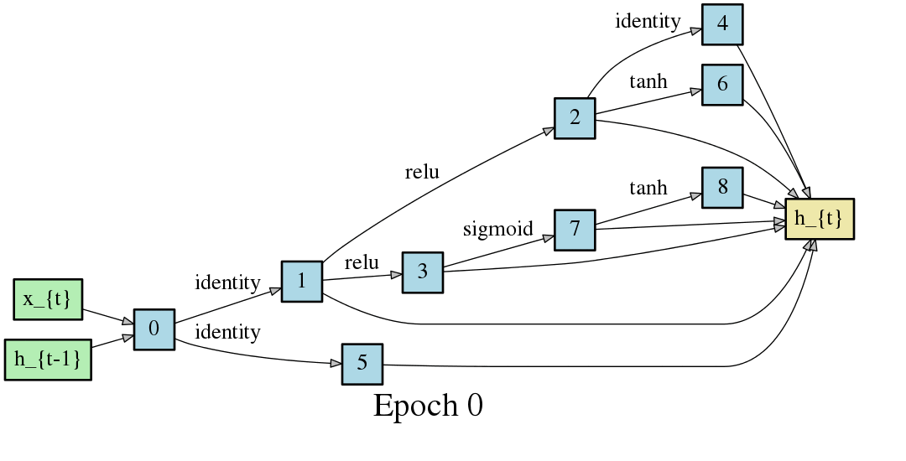
DARTS: Differentiable Architecture Search
Liu, Hanxiao, Karen Simonyan, and Yiming Yang. "Darts: Differentiable architecture search." arXiv preprint arXiv:1806.09055 (2018).

Slide 3
POS Tagging Results

Slide 4
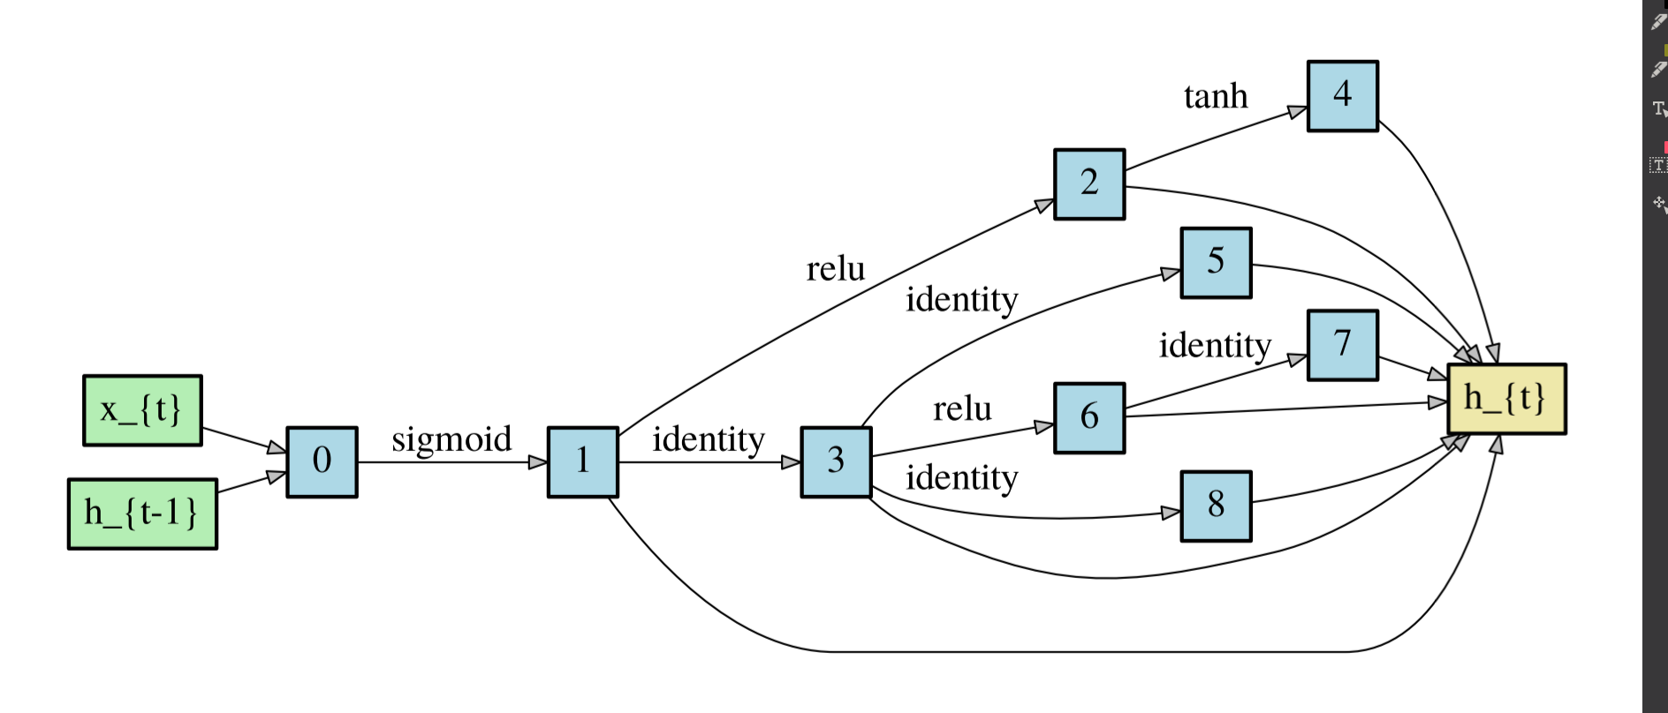
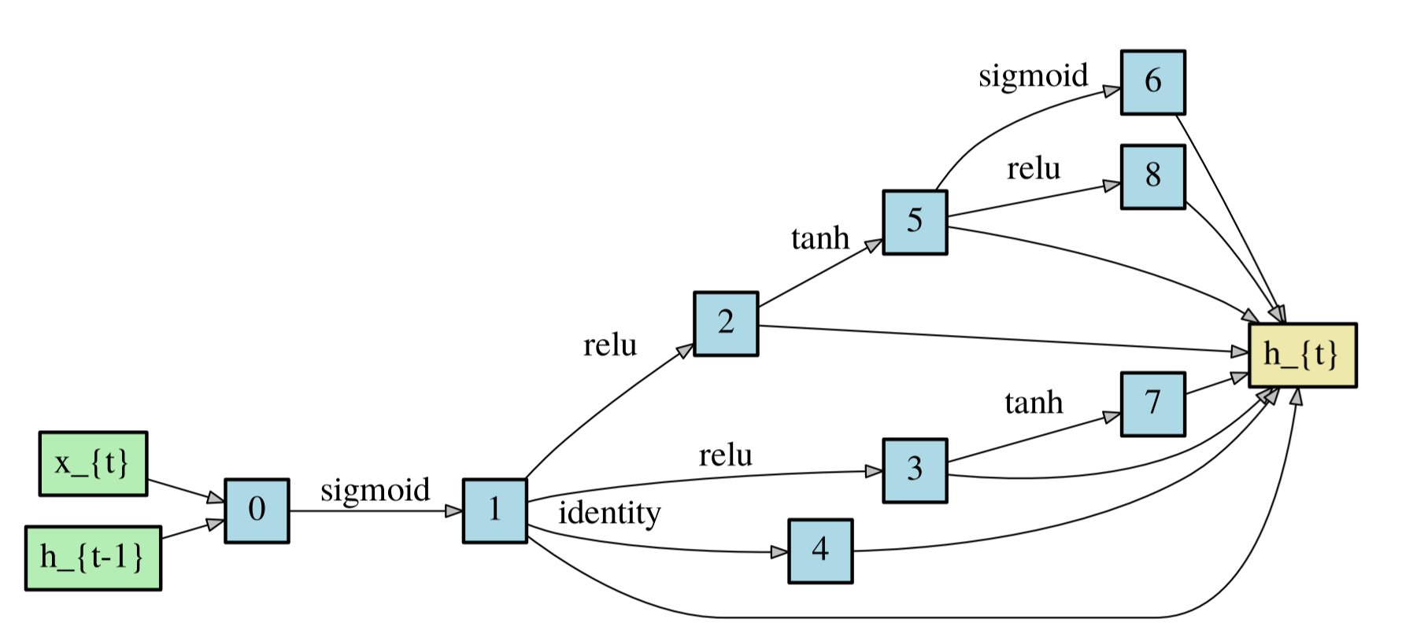
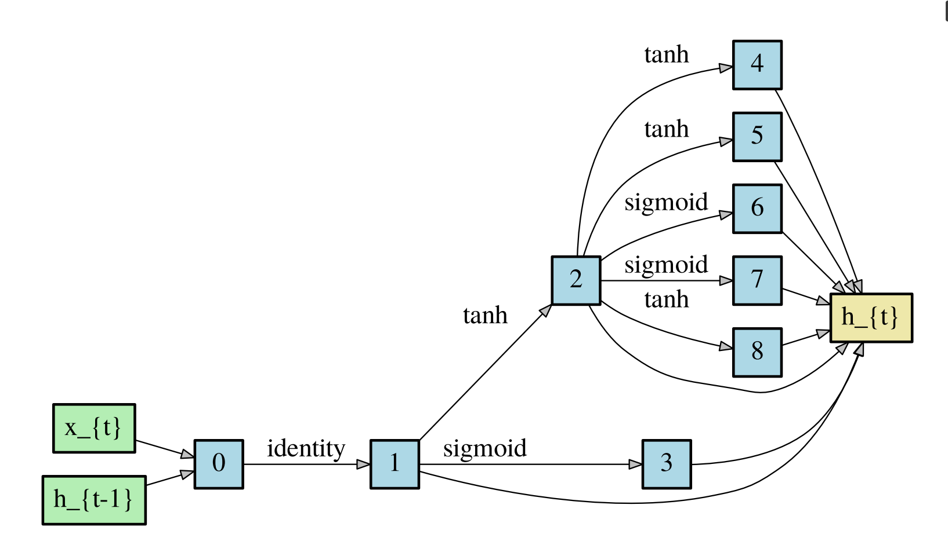
Choose Your Network!

Slide 5
23 | 14 | 18 | 5
Afrikaans | Ancient Greek | Bulgarian | Galician
Ancient Greek | Arabic | Chinese | Japanese
Basque | Catalan | Czech | Korean
Czech | Croatian | Czech | Latin
Danish | English | Estonian | Slovak
Dutch | Finnish | French
Dutch | French | German
English | Hebrew | Greek
English | Italian | Hungarian
Finnish | Norwegian | Latvian
French | Norwegian | Old French
Gothic | Portuguese | Persian
Hindi | Slovenian | Polish
Indonesian | Swedish | Romanian
Italian |  | Turkish
Korean |  | Ukrainian
Latin |  | Urdu
Old Church Slavonic |  | Vietnamese
Polish
Russian
Serbian
Spanish
Uyghur

Slide 6
French: 3-way tie. Not shown: Ancient Greek, Basque, Catalan, Galician, Gothic, Latin, Old Church Slavonic, Old French, Uyghur

